Slide 2

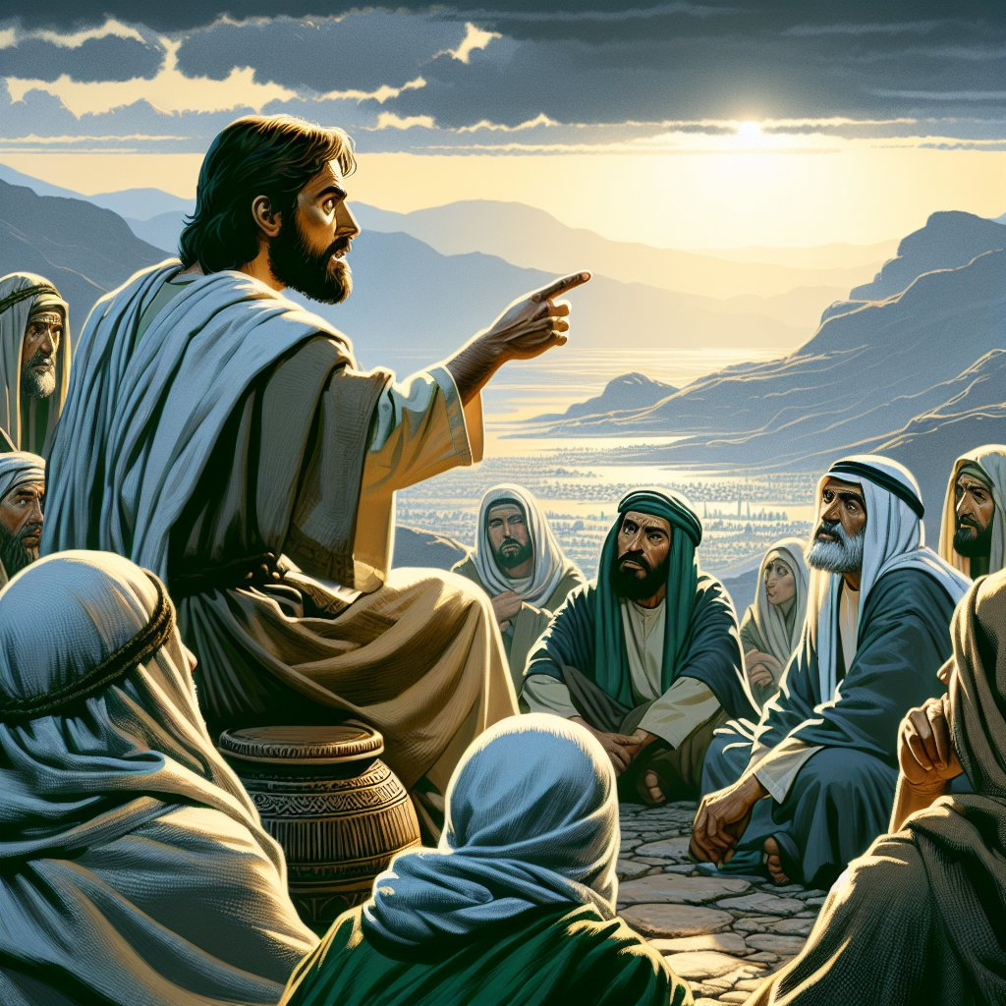

“A Little
While”
John 16:19
2 Timothy 3:16,17

Slide 3
Question About The “Little While”
John 16:19 “A little while, and you will not see Me; and again a little while, and you will see Me’”
John 16:17 “What is this that He says to us”
John 16:18 “We do not know what He is saying."
The Answer Is Given: John 16:20-23 “Most assuredly, I say to you that you will weep and lament, but the world will rejoice; and you will be sorrowful, but your sorrow will be turned into joy.”

Slide 4
Question On Greatness
Matthew 18:1-4 “Who then is greatest in the kingdom of heaven?”
A Manifestation Of “Pride Of Life.”
Matthew 20:20,21 "Grant that these two sons of mine may sit, one on Your right hand and the other on the left, in Your kingdom."
Matthew 18:2 “…unless you are converted and become as little children, you will by no means enter the kingdom of heaven. 4 Therefore whoever humbles himself as this little child is the greatest in the kingdom of heaven.”

Slide 5
Question On Divorce
Matthew 19:3-12 “Is it lawful for a man to divorce his wife for {just} any reason?”
Get tired of her? If she gets old? Burns the bread?
The answer: "Therefore what God has joined together, let not man separate."
Moses allowed because of the hardness of hearts!
“From the beginning, it was no so”
“whoever divorces his wife, except for sexual immorality, and marries another, commits adultery”

Slide 6
Question On The Tribute Money
Matthew 22:17-22 “Is it lawful to pay taxes to Caesar, or not?"
Matthew 22:15 “Pharisees went and plotted how they might entangle Him in His talk."
Matthew 22:16 “You do not regard the person of men."
His Answer: “Whose image and inscription {is} this?" "Render therefore to Caesar the things that are Caesar's, and to God the things that are God's."

Slide 7
Question About The Resurrection
Matthew 22:24-29,32 “Therefore, in the resurrection, whose wife of the seven will she be? For they all had her."
His Answer: “ You don't know the Scriptures nor the power of God.” [Vs. 29]
No marriages in heaven. [Vs. 30]
“God is not the God of the dead, but of the living." [V.32]

Slide 8
Question About The Great Commandment
Matthew 22:34-40 "Teacher, which {is} the great commandment in the law?"
His Answer: “You shall love the Lord your God with all your heart, with all your soul, and with all your mind.’” [Vs. 37] “You shall love your neighbor as yourself.” [Vs. 39]
ALL of God’s commandments hang on these two [Vs.40]

Slide 9
Question From Rich Young Ruler
Matthew 19:16 “ what good thing shall I do that I may have eternal life?"
His Answer: “if you want to enter into life, keep the commandments." [Vs. 17]
What does it mean for US TODAY?
Keep The Law Of Jesus Christ! Galatians 6:2 “and so fulfill the law of Christ.”
1 Corinthians 9:19-22 “ (not being without law toward God, but under law toward Christ)

Slide 10
What Did Jesus SAY?
John 14:15 NKJV 15 "If you love Me, keep My commandments.”
Mark 16:15-16 NKJV 15 “And He said to them, "Go into all the world and preach the gospel to every creature. 16 "He who believes and is baptized will be saved; but he who does not believe will be condemned.”
Are You?
Would you?
IF NOT, WHY NOT?

